Slide 1
Jenkins – Tools Integration
CI/CD Automation Tool
Manoj D
June 2020

Slide 2
Agenda
Jenkins Pipeline stage Overview
SCM Integration
Build tools Integration
Testing
Deployment
Notification

Slide 3
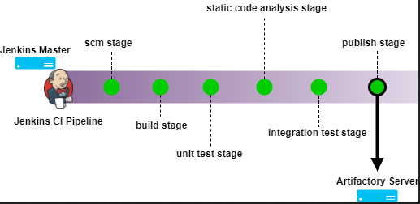
Jenkins Integrations

Slide 4

Plugins
Git/Subversion ------ SCM
Ant/Maven/MS-Build/Gradle ----- Build
SonarQube Scanner ----- Code Quality
Artifactory ---- Binary Repository
Tomcat/ Publish Over SSH/Ansible Tower ---- Deployment
Email Extension ---- Notification

Slide 5
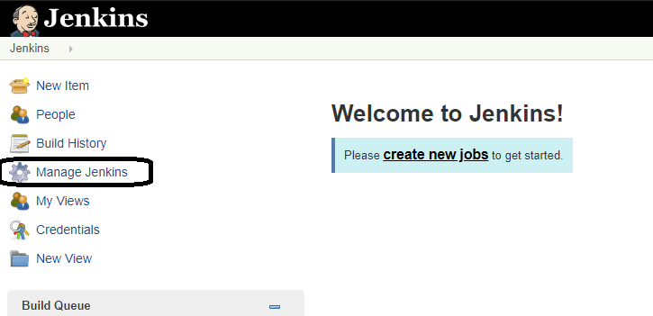
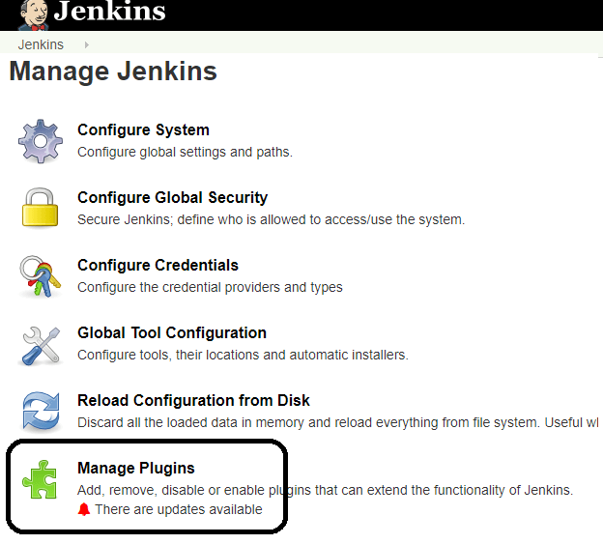
Jenkins – Git Setup
GitHub is a web-based repository of code with SCM features. Jenkins need GitHub plugin to be installed to pull code from GitHub repository.
Step 1: Click on the Manage Jenkins button on your Jenkins dashboard:
Step 2: Click on Manage Plugins:

Slide 6
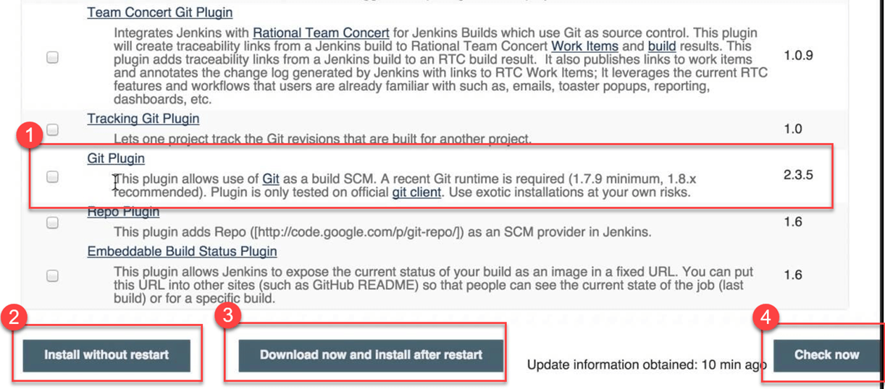
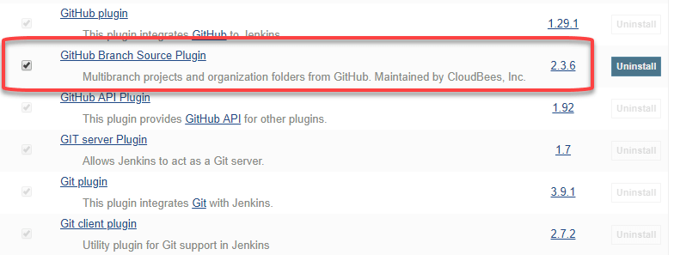
Step 3: In the Plugins Page
Select the GIT Plugin
Click on Install without restart. The plugin will take a few moments to finish downloading depending on your internet connection, and will be installed automatically.
You can also select the option Download now and Install after restart button. In which plugin is installed after restart
You will be shown a "No updates available" message if you already have the Git plugin installed.
Step 4: Once the plugins have been installed, go to Manage Jenkins on your
Jenkins dashboard. You will see your plugins listed among the rest.

Slide 7
Jenkins Configuration
Configure System
* Jenkins Home Directory
* Number of executors in master
* Environment Variables
Global Tool Configuration

Slide 8
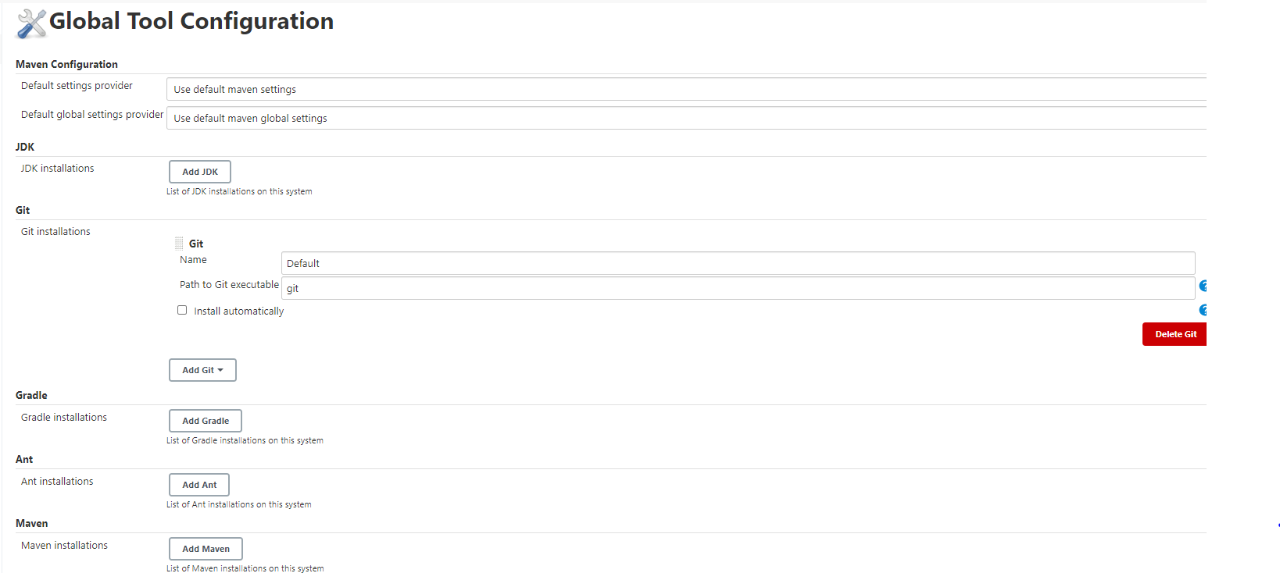

Slide 9
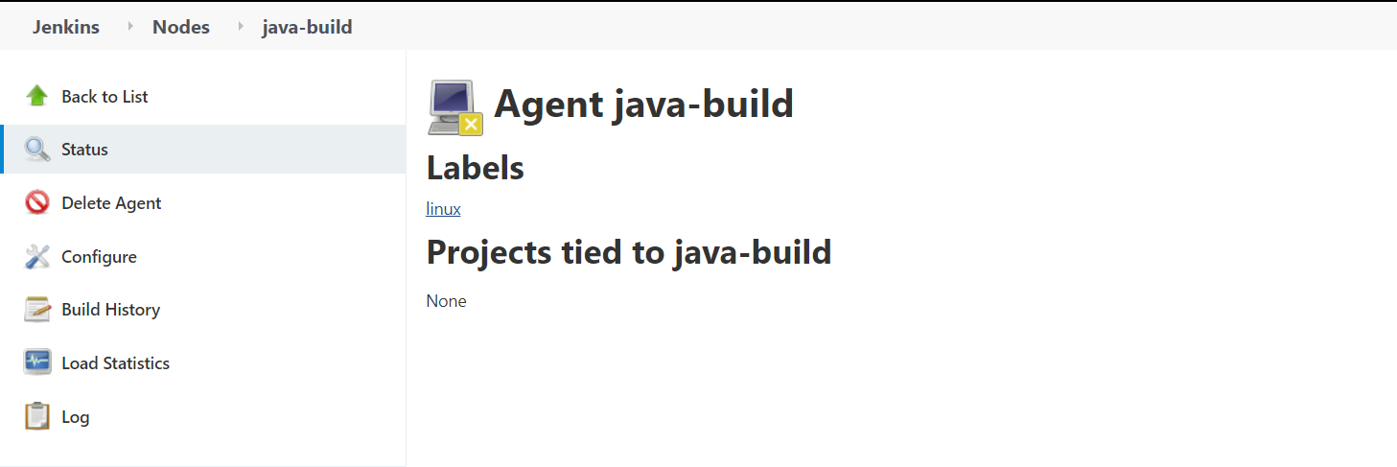
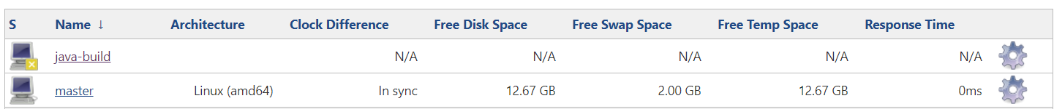
Build Agent

Slide 10
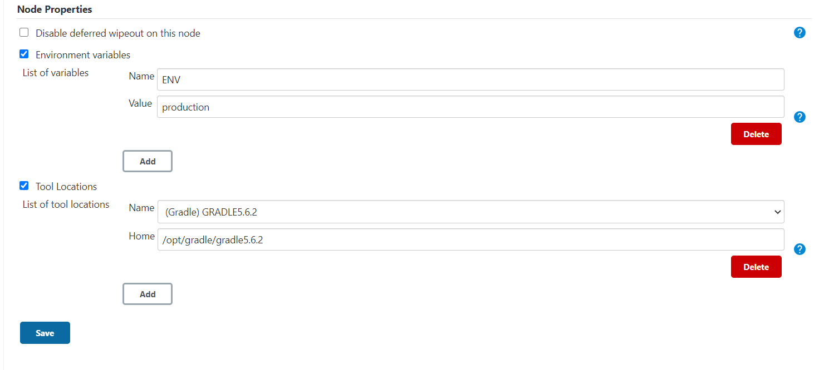
Build Machine Tool Configuration

Slide 11
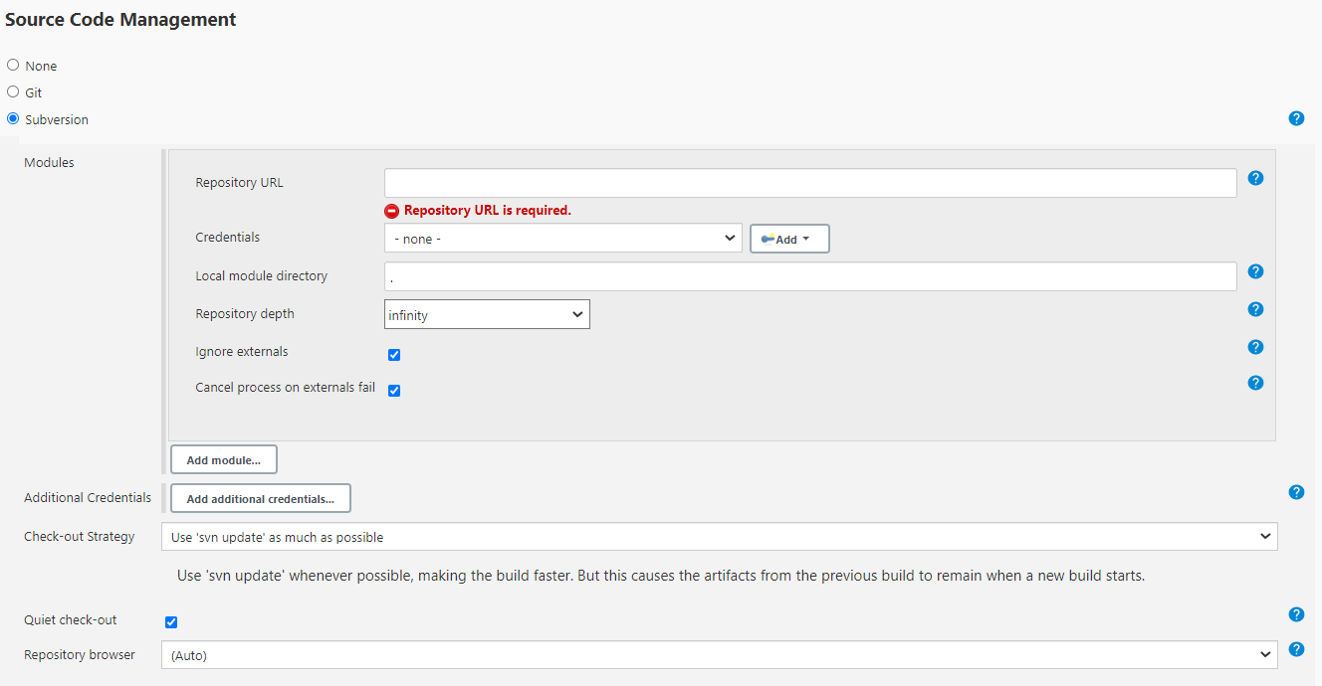
SCM Tool integration

Slide 12
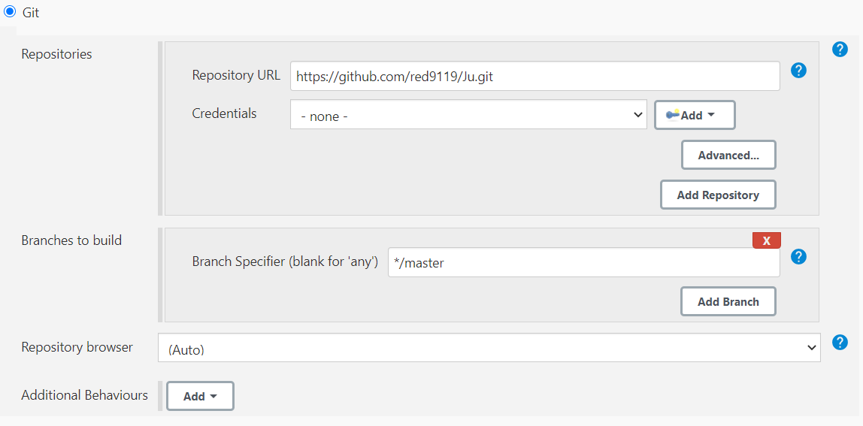
SCM Tool integration

Slide 13
Jenkinsfile
node(“java-build”) {
stage(“SCM”) {
checkout scm: [$class: 'GitSCM', branches: [[name: '*/master']], doGenerateSubmoduleConfigurations: false, extensions: [], submoduleCfg: [], userRemoteConfigs: [[url: 'https://github.com/red9119/ju.git']]]
}
}

Slide 14
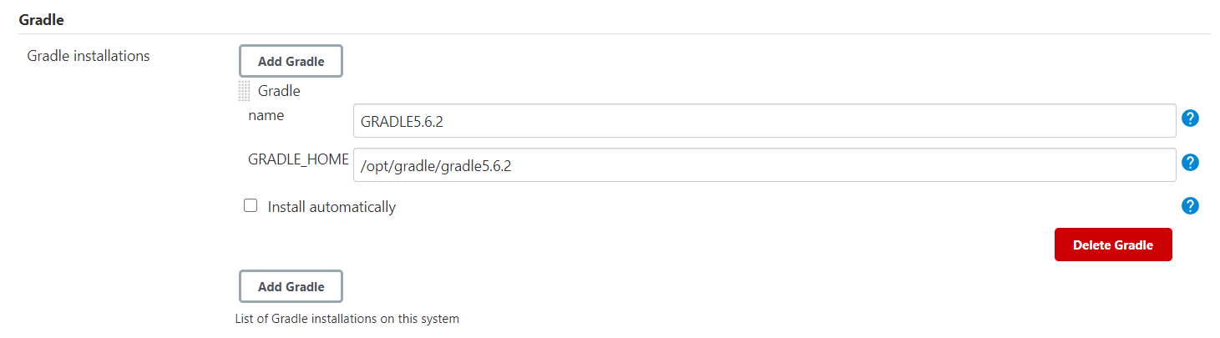
Build Tool integration
In Global Tool Configuration

Slide 15
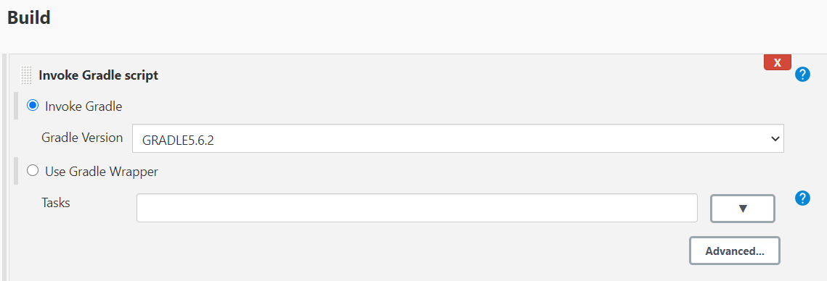
Build Tool integration

Slide 16
Jenkinsfile
stage(“Build”) {
def mvnHome = tool “MAVEN3.6.3”
sh “ ${mvnHome}/bin/mvn –f pom.xml clean install ”
}

Slide 17
Testing
Unit test: Specify and test one point of the contract of single method of a class. This should have a very narrow and well defined scope. Complex dependencies and interactions to the outside world are stubbed or mocked.
Integration test: Test the correct inter-operation of multiple subsystems. There is whole spectrum there, from testing integration between two classes, to testing integration with the production environment.
Smoke test (aka Sanity check): A simple integration test where we just check that when the system under test is invoked it returns normally and does not blow up. It is an analogy with electronics, where the first test occurs when powering up a circuit: if it smokes, it's bad.

Slide 18
Jenkinsfile
stage(“unitTest”) {
def mvnHome = tool “MAVEN3.6.3”
sh “ ${mvnHome}/bin/mvn –f pom.xml test”
}
stage(“smokeTest”) {
def mvnHome = tool “MAVEN3.6.3”
sh “ ${mvnHome}/bin/mvn –f smoke/pom.xml test”
}

Slide 19
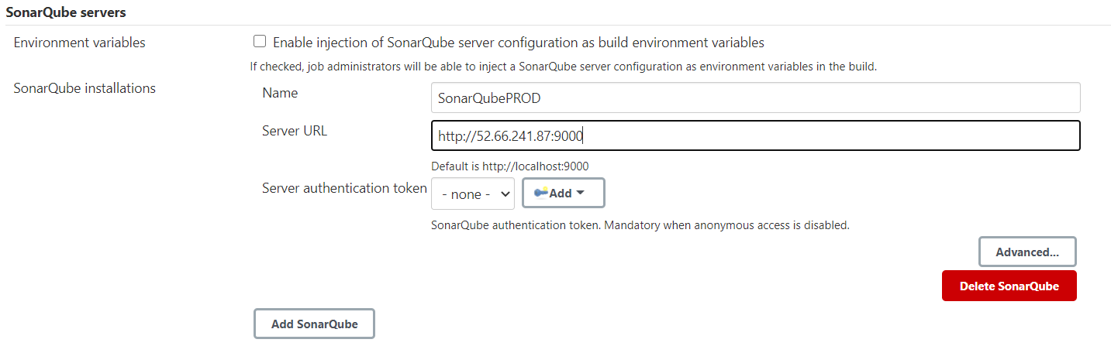
Code Quality
In Configure system

Slide 20
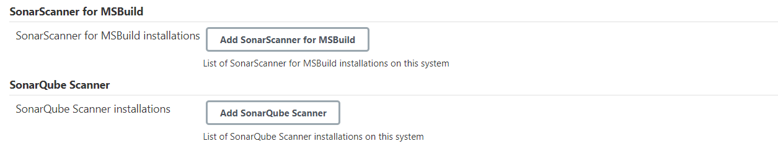
Code Quality
In global tool configuration

Slide 21
Jenkinsfile
stage(“sonar”) {
def scannerHome = tool “SonarScanner”
withSonarQubeEnv(“SonarQubePROD”) {
sh “${scannerHome}/bin/sonar-scanner –Dsonar.projectKey=Demo –Dsonar.projectName=Demo ”
}
}

Slide 22
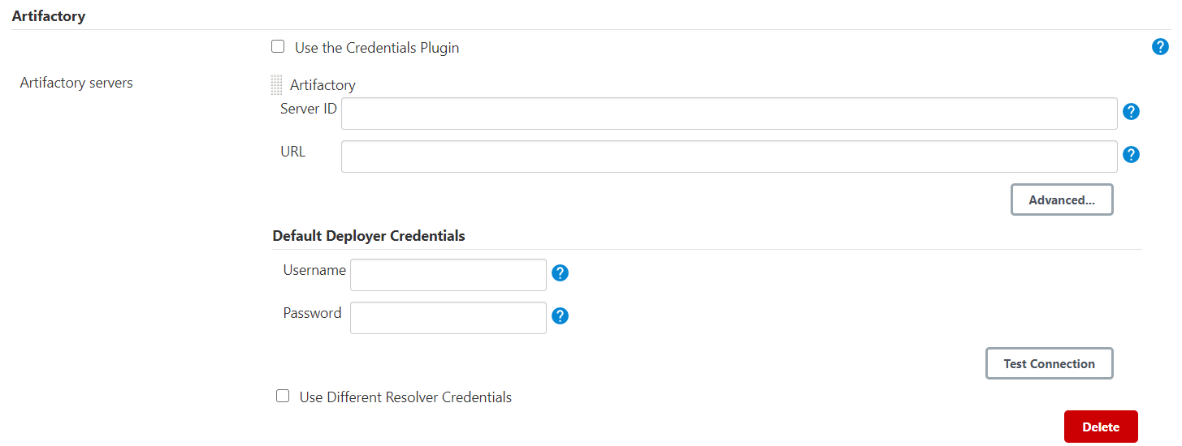
Artifactory
In configure system

Slide 23
Jenkinsfile
def server = Artifactory.server.”server-id”
Stage(“Artifact upload”) {
def uploadSpec = """{
"files": [
{
"pattern": “demo.jar",
"target": “libs-release/demo-${BUILD_NUMBER}"
}
]
}"""
server.upload spec: uploadSpec
}
Stage(“Artifact Download”) {
def downloadSpec = """{
"files": [
{
"pattern": "libs-release/demo-${BUILD_NUMBER}/demo.jar ",
"target": “downloadedArtifact"
}
]
}""“
server.download spec: downloadSpec
}

Slide 24
DEPLOYMENT

Slide 25
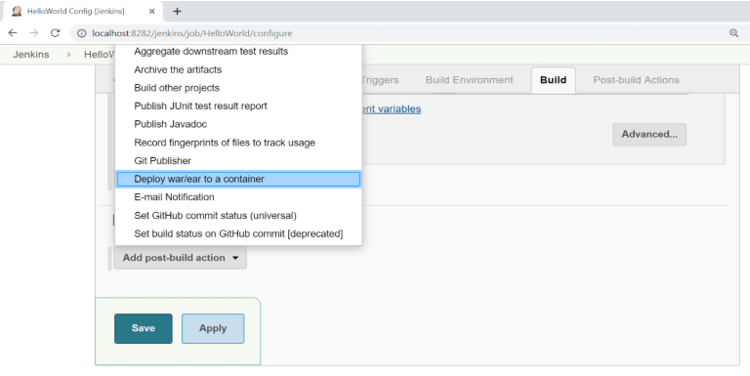
Tomcat Deployment

Slide 26
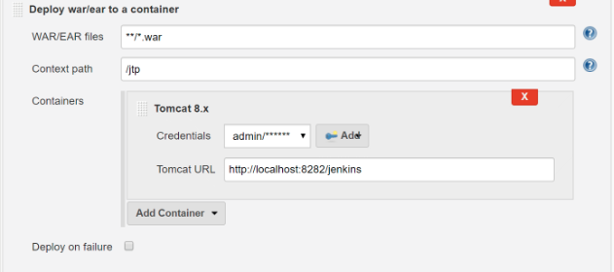
Tomcat build step

Slide 27
Deployment via scp and ssh
stage(‘Deploy') {
sshPublisher(
continueOnError: false, failOnError: true,
publishers: [
sshPublisherDesc(
configName: "${env.SSH_CONFIG_NAME}",
verbose: true,
transfers: [
sshTransfer(
sourceFiles: "${path_to_file}/${file_name}, ${path_to_file}/${file_name}",
removePrefix: "${path_to_file}",
remoteDirectory: "${remote_dir_path}",)
])
])
}

Slide 28
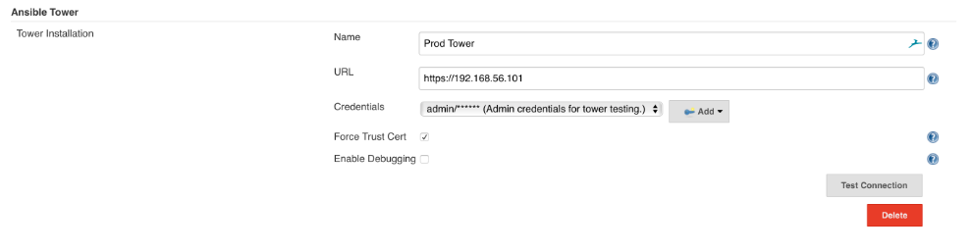
Ansible Tower Integration
In configure system

Slide 29
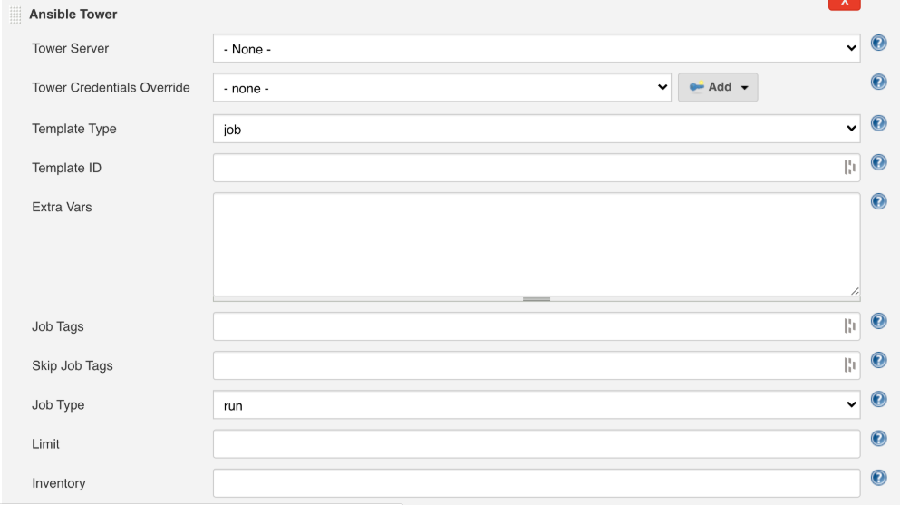
Ansible Tower Integration

Slide 30
Notification
In all cases, a CI server must let the right people know about any new issues/Status/Build Failures, and it must be able to do so fast.
Passive notification (pull) requires the developers to consciously consult the latest build status, and includes RSS feeds, build radiators
Active notification (push) will proactively alert the developers when a build fails, and includes methods such as desktop notifiers, Slack and SMS.

Slide 31
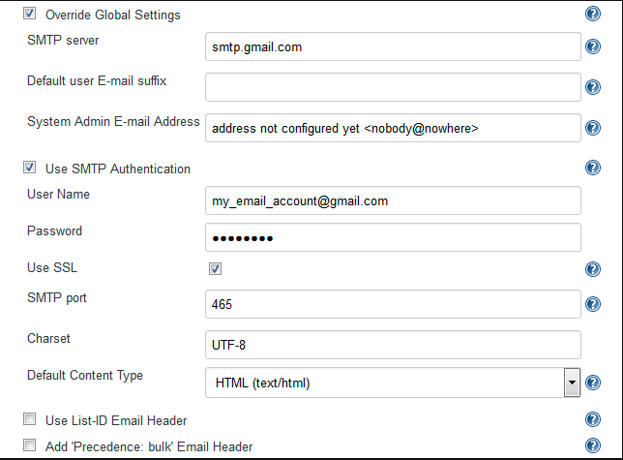
Configuration for email-notification
In configure system

Slide 32
Jenkinsfile
stage(“Build Notification”) {
emailext body:”Link: ${env.BUILD_URL}/console” , subject: “Prod Deployment Successful” , to: “manoj@cognizant.com”
}

Slide 33
Thank You Manoj D – 670389

